Slide 1
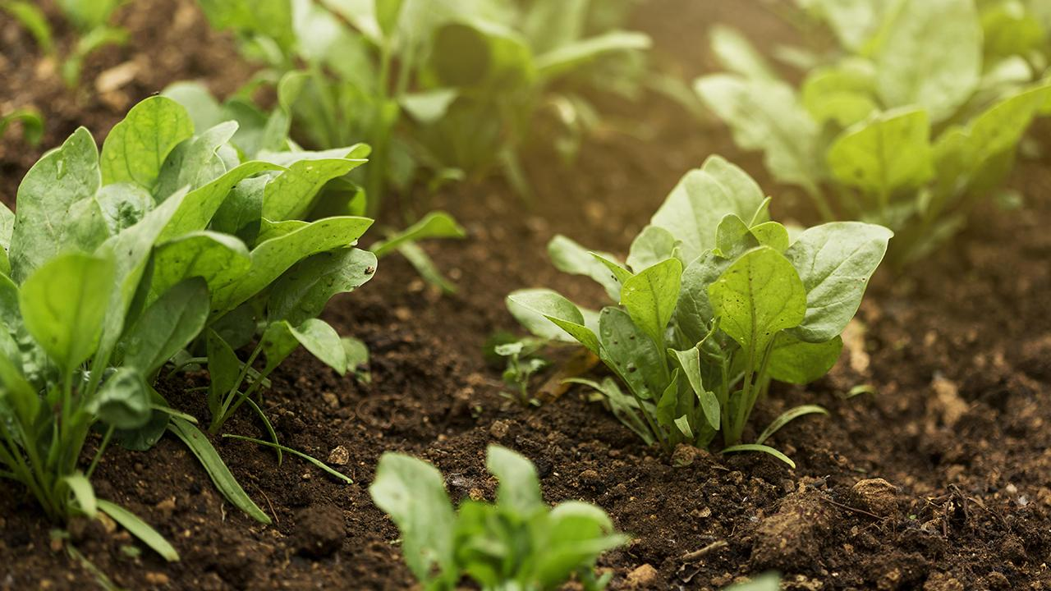
AgriBot
Under the supervision of Dr. Zainab Hassan

Slide 2
Team members
Moghazy refaat
Elsaeed Mohamed
Mohamed omar
Ahmed elsaid ali
Ahmed elsaid Mohamed
Omar Mohamed kamel
Omar alaa kamel
Moaz Al-Dessouki
Ramadan elsaid
Fawzy ibrahim

Slide 3
1.Introduction 2. Motives for problem 3.system architecture 4.NPK sensor 5.Benefits of "NPK sensor” 6.project component 7. circuit and connections 8.combarsion
Table of contents
9.Data Flow Diagram
10.Why Do We Use (ML) Model
11.Our ML model
12.Results
13.Web page
14.Use case
15. Challenges
16. Summary

Slide 4
The world's population is expected to reach 9.8 billion by 2050, increasing pressure on food resources. The world faces significant challenges in food production due to limited agricultural land, water scarcity, and climate change, in addition to the impact of pests, diseases, and extreme weather conditions on agricultural production.
Introduction

Slide 5
Egypt faces similar challenges, including scarcity of arable land, water shortages, and climate change, which threaten food security. Meeting these challenges is essential to ensure sustainable food production and economic stability in the country
Introduction

Slide 6
Motives for problem
1.Water scarcity and limited arable land in many regions. 2.Farmers struggle to choose the right crops for their soil. 3.Traditional methods of soil testing are time-consuming and expensive.

Slide 7
system architecture
Soil sensor collects seven key soil metrics.
Arduino processes raw sensor data.
Data is sent to Raspberry Pi for analysis using ML model.
Results are displayed on a connected LCD screen.

Slide 8
NPK 5 pins soil sensor
It is a comprehensive sensor used in smart agriculture and is a powerful tool for improving agricultural productivity and facilitating the agricultural process for farmers.
By measure 7 important soil elements:
Nitrogen (N)
Phosphorus (P)
Potassium (K)
Moisture (Moisture)
Temperature (Temperature)
Electrical Conductivity (EC)
pH (pH)

Slide 9
Benefits of "NPK sensor”
crop classification
determining soil acidity
discovering new agricultural lands
maintaining soil quality,
addressing nutrient deficiencies.

Slide 10
Benefits of "NPK sensor”
Reduction in Environmental Pollution
Supporting Eco-Friendly Practices
Encouraging Data-Driven Agricultural Policies

Slide 11
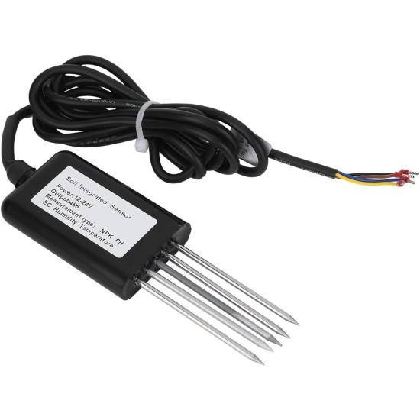
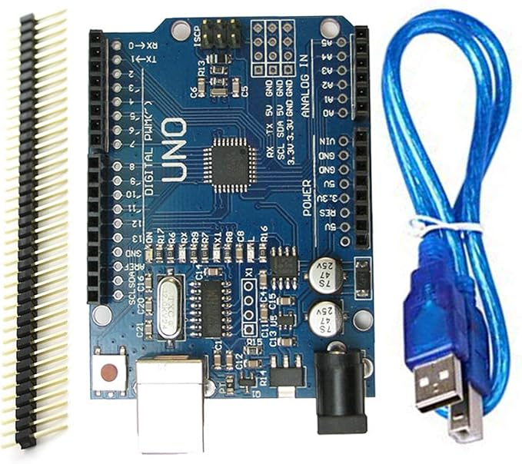
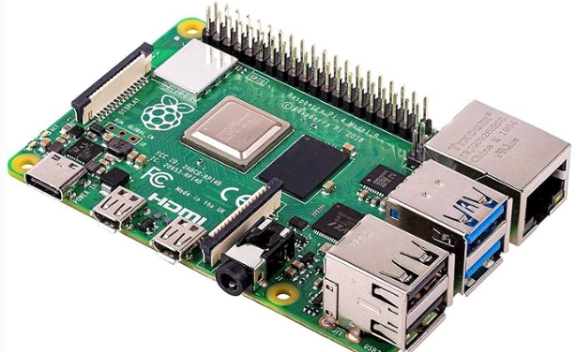
project component
NPK 7 in 5 sensor
Arduino Uno
Raspberrypi 6
Soil sensor measure 7 component
Collect component and send to raspberrypi
Make crop recommondation

Slide 12
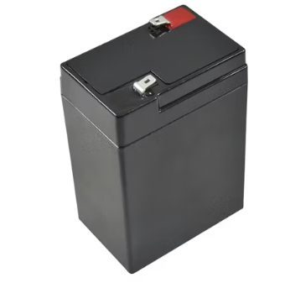
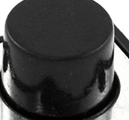
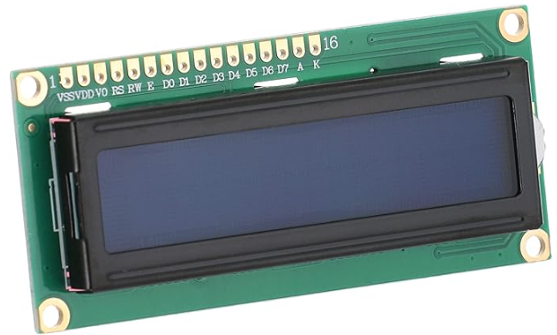
project component
Batteries
Button
LCD

Slide 13
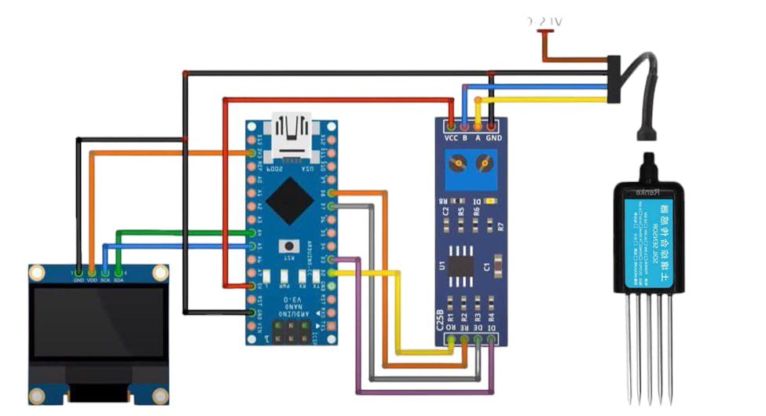
circuit and connections

Slide 14
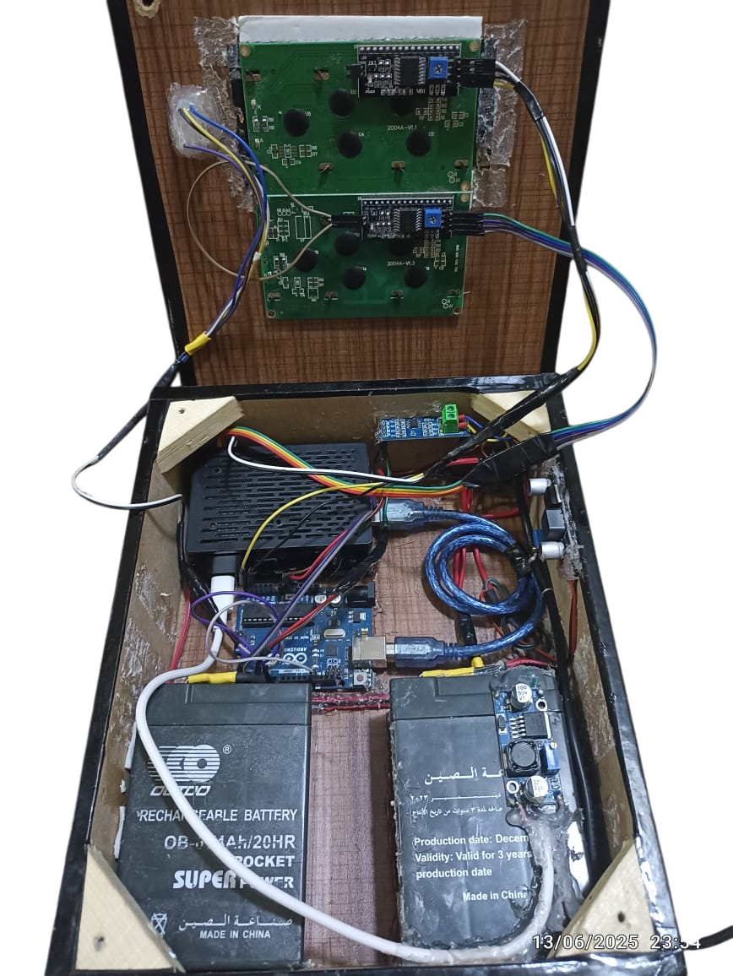
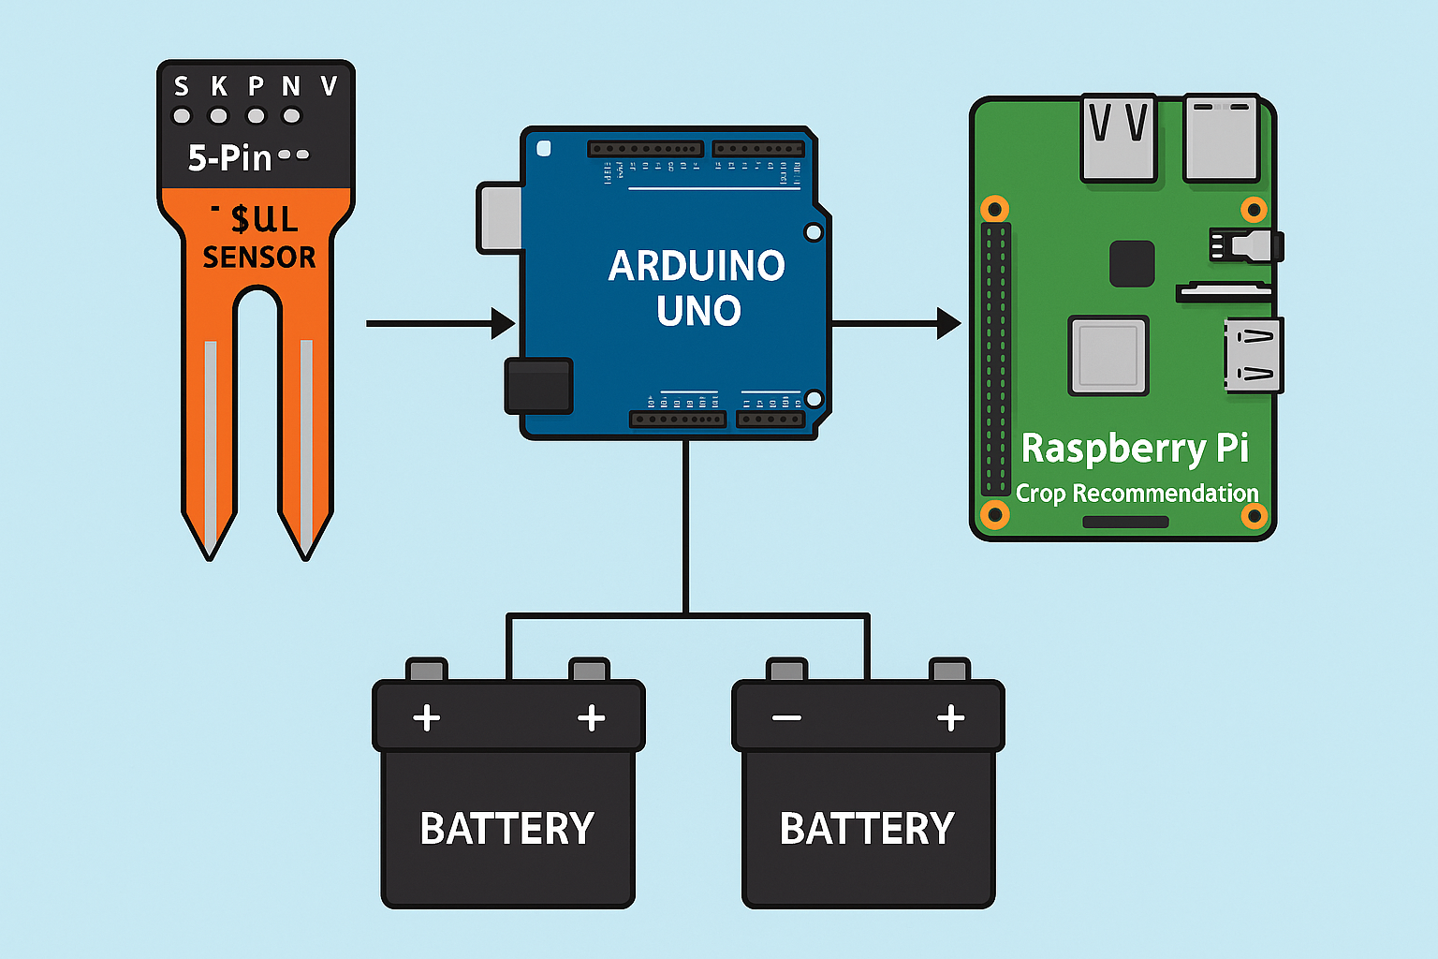
circuit and connections

Slide 15
Why ML model
Analyze complex patterns in soil and climate data.
Recommend the best crops based on real-time conditions.
Adapt and improve over time as more data is collected.
Save time, reduce costs, and increase productivity.

Slide 16
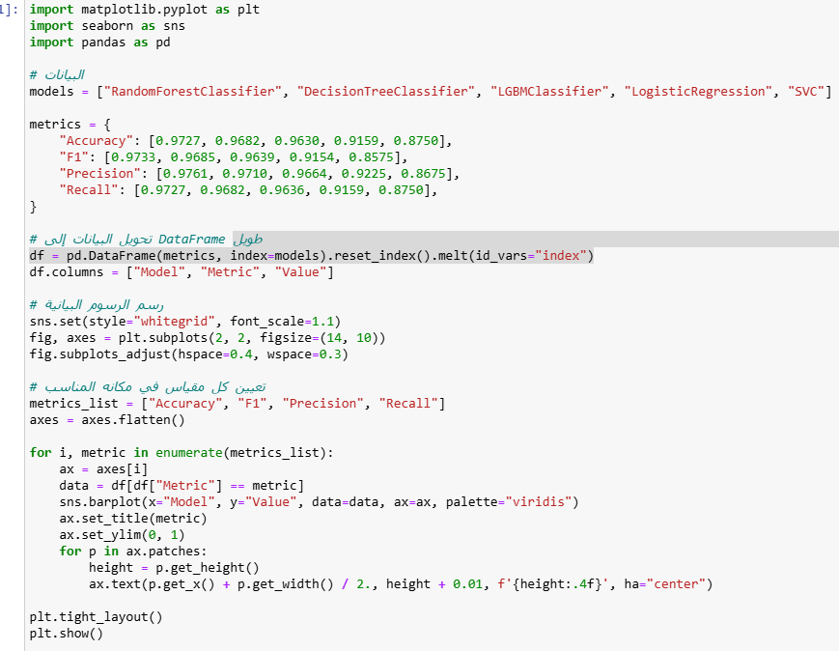
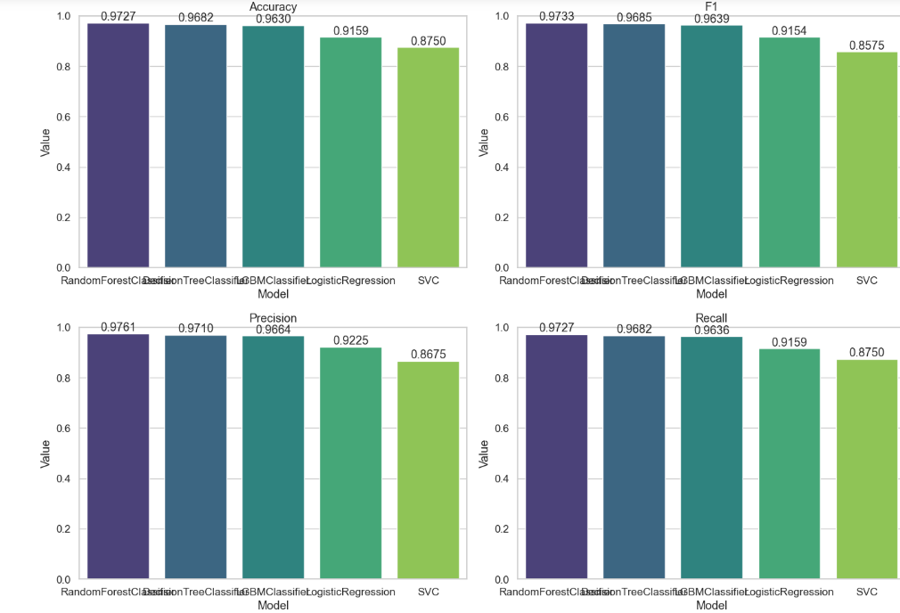
ML model

Slide 17
Results
Model | accuracy | precision | recall | f1
LogisticRegression | 0.9159 | 0.9225 | 0.9159 | 0.9154
DecisionTreeClassifier | 0.9682 | 0.9710 | 0.9682 | 0.9685
RandomForestClassifier | 0.9728 | 0.9761 | 0.9727 | 0.9733
LGBMClassifier | 0.9636 | 0.9664 | 0.9636 | 0.9639
SVC | 0.8750 | 0.8675 | 0.8750 | 0.8575

Slide 18
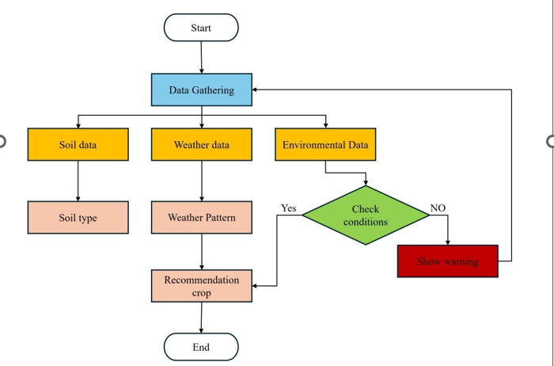
Flow chart Diagram

Slide 19
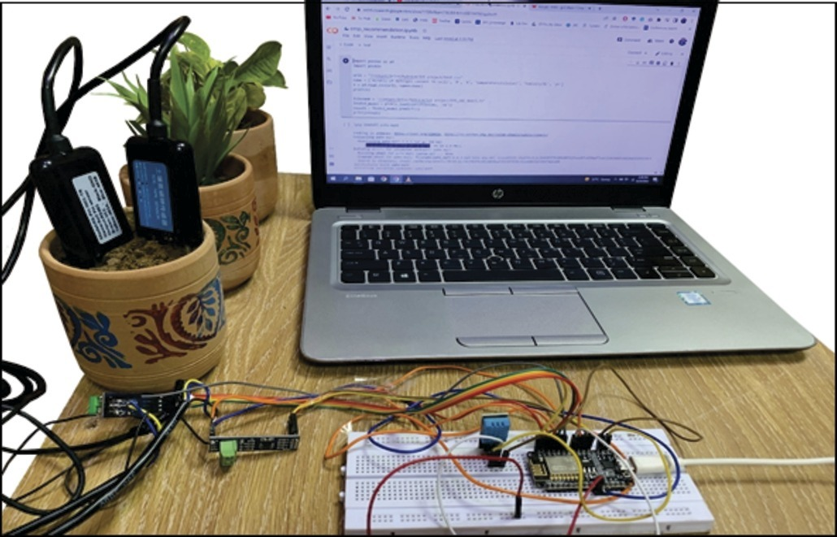
Another project

Slide 20
Comparing with other project
Many agricultural areas lack good or consistent internet coverage.
Relying on Wi-Fi can cause data transmission instability for farmers.
We used a built-in LCD display to display all measured values ​​directly on the device, so farmers can read the data.

Slide 21
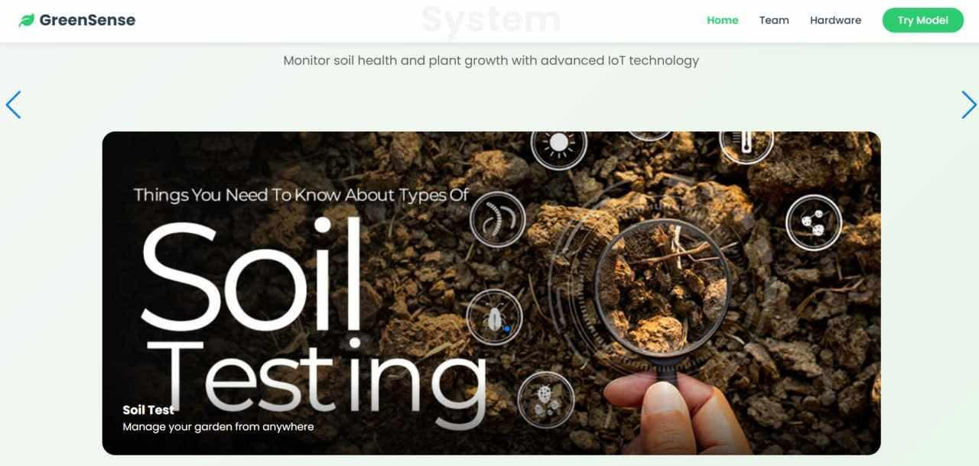
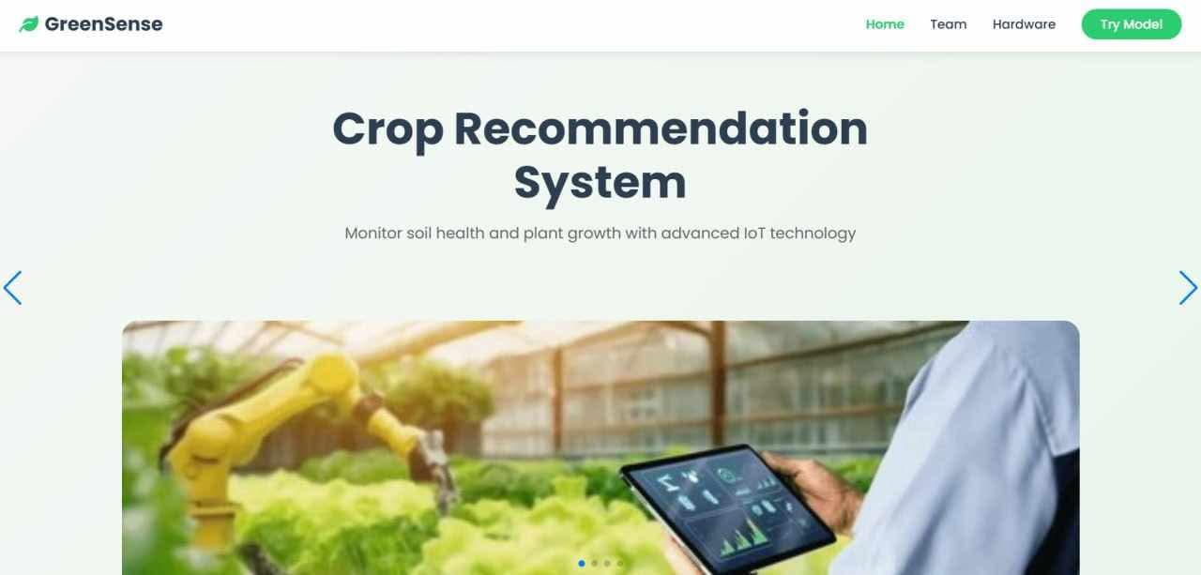
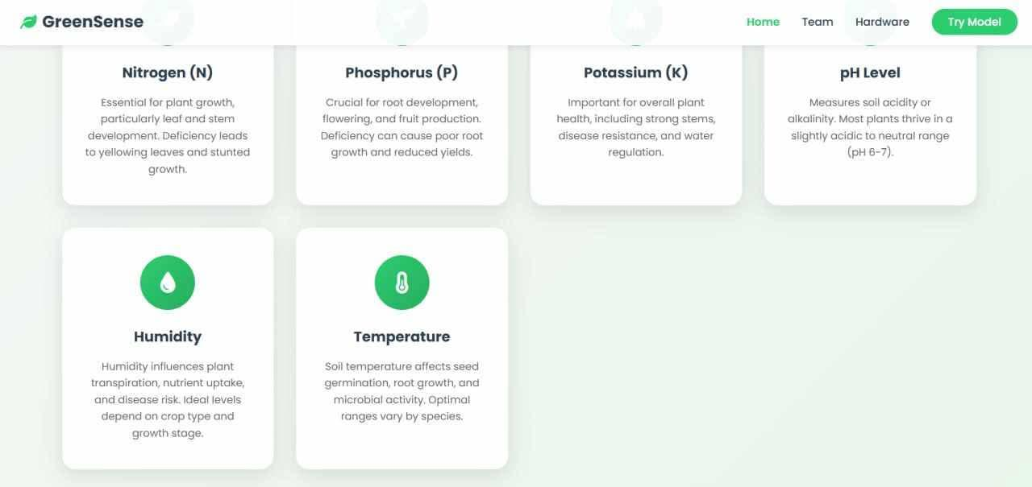
Web page

Slide 22
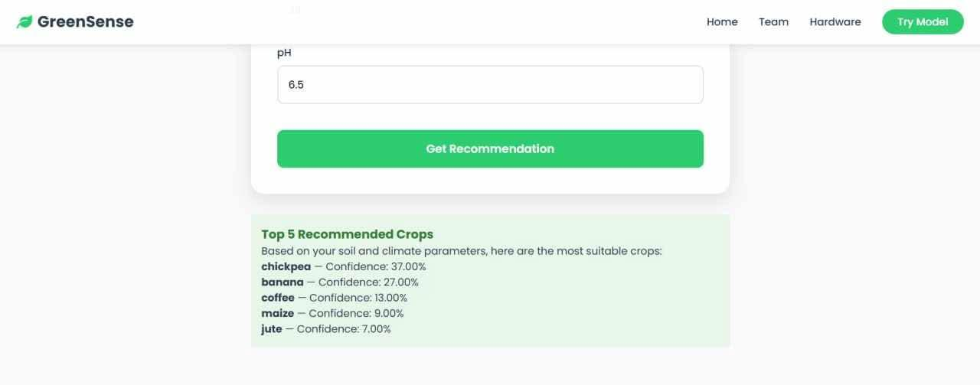
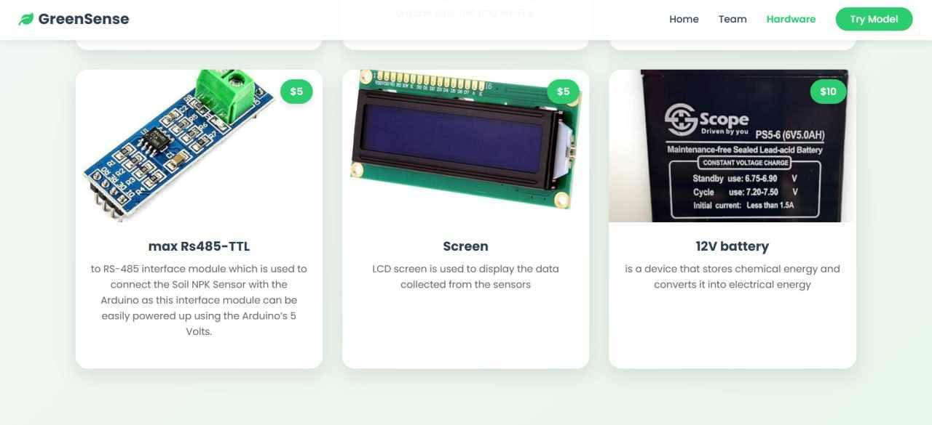
Web page
Page link:http://127.0.0.1:5500/

Slide 23

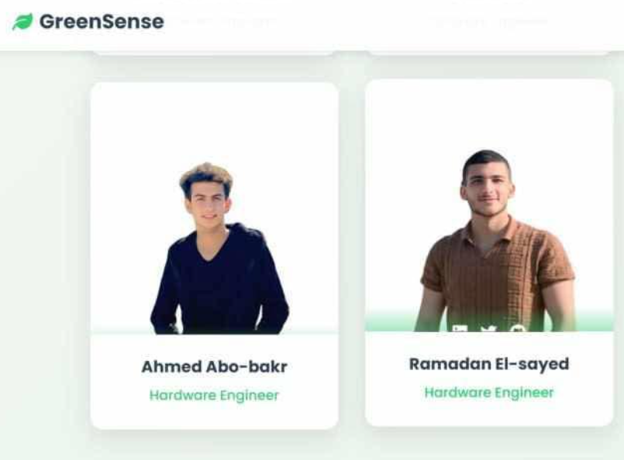
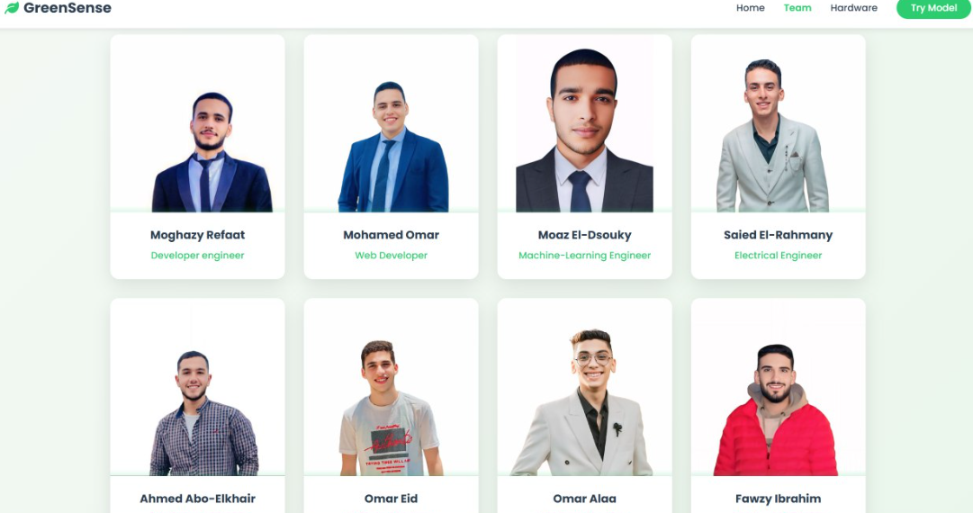
Web page

Slide 24
Challenges
Collecting high-quality soil data for training.
Integrating multiple hardware components smoothly.
Ensuring power efficiency in rural environments.

Slide 25
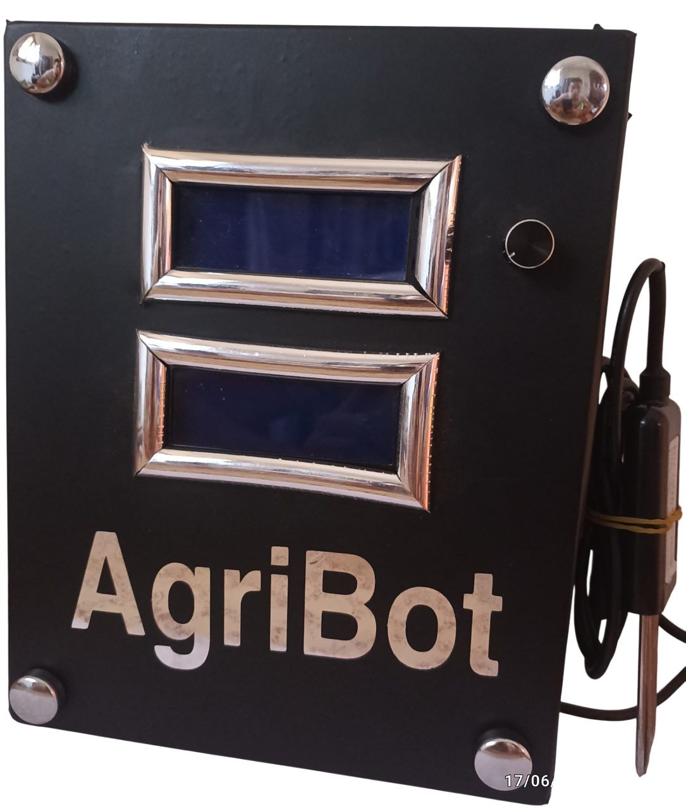
Project summary
The NPK Bot offers an innovative solution for smart agriculture.
It bridges the gap between soil analysis and crop selection.
A step forward in sustainable, tech-driven farming.

Slide 26
Use case1

Slide 27
Use case 2

Slide 28
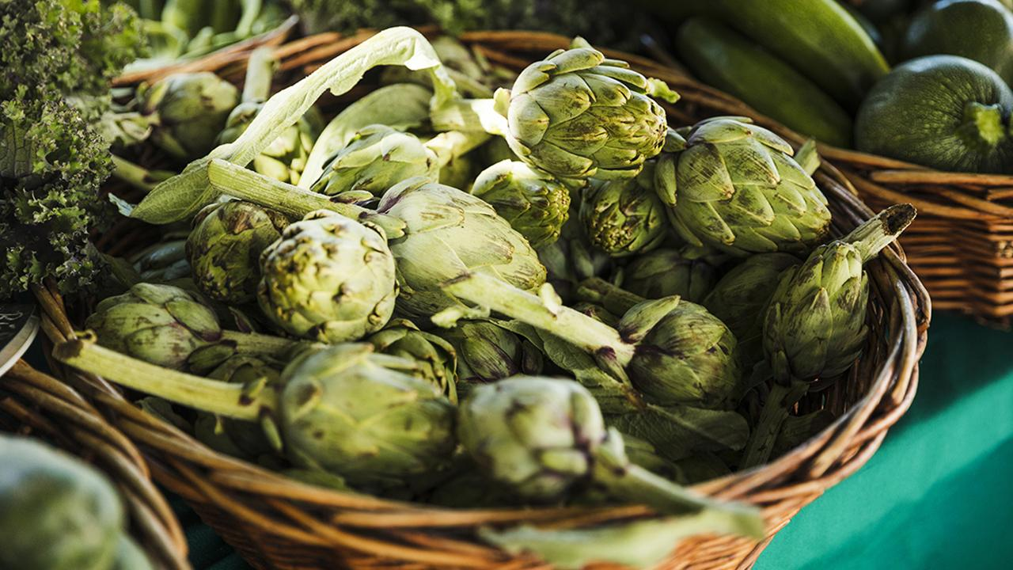
Thanks!
Do you have any questions?

